Slide 1
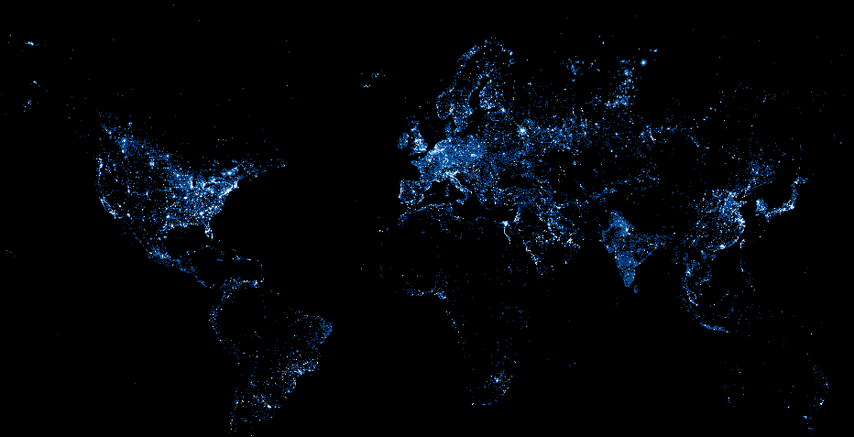
Using Night Lights to Measure Economic Growth
Peter Rasmussen
Notes:
Having worked in multiple Sub-Saharan African countries,
I can attest to fact that socioeconomic data that is readily available for communities in the US – that we take for granted - is often not there in emerging markets
This is because traditional means of getting socioeconomic data can be imprecise or unavailable
For certain countries, it can be difficult to get country-level data, let alone subnational data at the city and provincial levels
Getting good data is important
For instance, GDP data is valuable to governments to make policy, consultancies, local companies, multi-nationals, and the aid industry
Unfortunately, the best data is often locked behind paywalls or simply doesn’t exist

Slide 2
Issue: Data gaps in emerging markets
GDP
Syria
Afghanistan
Somalia
Notes:
Let’s see an illustration of this issue using GDP data for three conflict and post-conflict countries

Slide 3
Issue: Data gaps in emerging markets
GDP
Syria
Afghanistan
Somalia

Slide 4
Issue: Data gaps in emerging markets
How do we measure economic growth in places where statistics are imprecise or unavailable?

Slide 5
Hypothesis
We can use satellite night light imagery to measure GDP
Notes:
Fill in the gaps

Slide 6
Hypothesis
Syria
Afghanistan
Somalia
Notes:
Here we see intertemporal night light data for Syria, Afghanistan, and Somalia
We can use this information to fill in the gaps in GDP data

Slide 7
Methodology
Data
Analysis
250+ country-level regressions
XXXXXX city-level regressions
Comparison to other datasets
Notes:
Data from NOAA: 1992 to 2013
GDP data from World Bank
250 country-level linear regressions to model how light intensity correlates with given country’s GDP
Then, I conducted the analysis for cities with populations greater than 1 million (as of 2009) to measure GDP at the local level

Slide 8
Results: Country-Level Regressions
r²
0.05
0.91

Slide 9
Results: Country-Level Regressions
Emerging markets tend to correlate to light better than developed / industrialized markets
Notes:
Correlation for developed / industrialized countries may be poorer because they are already electrified

Slide 10
Results: City-Level Regressions
Chart comparing these estimates against PwC, other estimates for top emerging market metros
Notes:
Going forward, we can use night light and other remote sensing imagery as proxies to measure historical and current economic activities
The possibilities are

Slide 11
Thank You!
Blog
pgr-me.github.io
peter.gray.rasmussen@gmail.com
pgr-me
petergrayrasmussen

